Slide 1
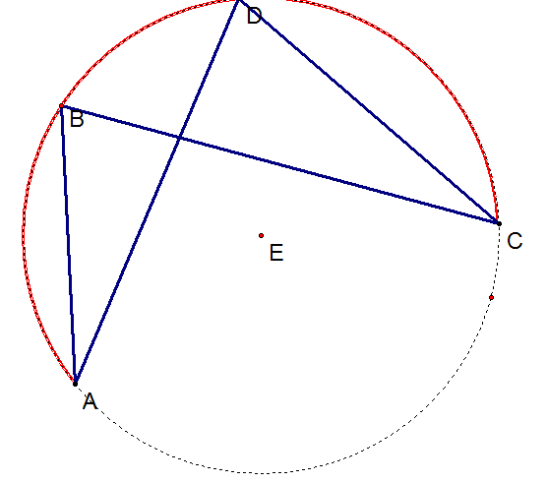
Angles on an arc are equal
Angle ADC = Angle ABC

Slide 2
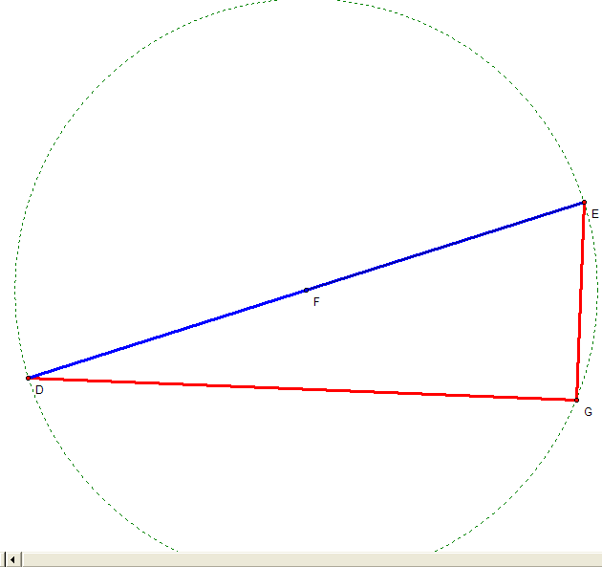
A triangle on a diameter is always right angled

Slide 3
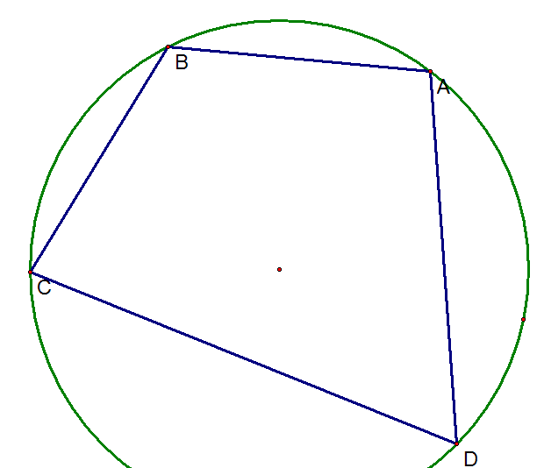
Opposite angles in a cyclic quadrilateral sum to 180º
A + C = 180 º
B + D = 180 º

Slide 4
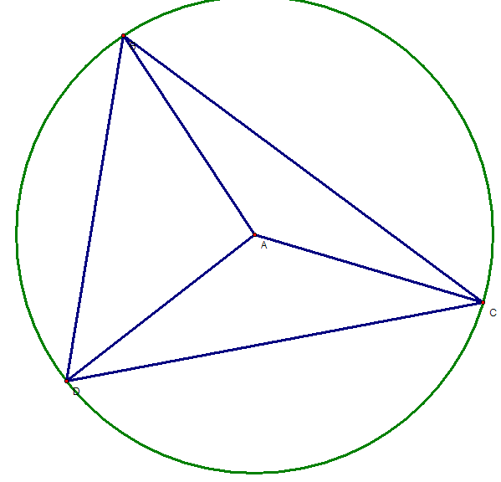
Triangles from the radius are isosceles

Slide 5
A triangle on a diameter is always right angled
Angles on an arc are equal
Angle ADC = Angle ABC
Triangles from the radius are isosceles
Opposite angles in a cyclic quadrilateral sum to 180º
A + C = 180 º
B + D = 180 º

